Slide 1
CS 2212B
Introduction to Software Engineering
Chapter 1 Key Principles – Software Life Cycle - Process

Slide 2
Copyright Notice This Presentation and Its Associated Video Contain Copyright Material. This Presentation and Its Associated Video Are Provided for Teaching Purposes of CS2212 and Should Not Be Posted In Any External Site, Or Shared with. This Presentation and Its Associated Video Are Provided For Instructional Personal Use Only, and Only For The Purposes of the CS2212 Course.

Slide 3
Part 4
Introduction to Software Life Cycle
When I’m working on a problem, I never think about beauty. I think only how to solve the problem. But when I have finished, if the solution is not beautiful, I know it is wrong.
— Freeman Dyson
Notes:
This lesson introduces the basic steps in a software engineering project at a high level.
In practice, steps often overlap.

Slide 4
Learning Objectives in this Part
To understand what the software life-cycle is

Slide 5
Software Life Cycle
Software is a complex engineering product and cannot be produced in a single step.
The development or enhancement of a software system starts as an idea, which becomes a set of requirements, which are represented as models, and perhaps as a prototype, which are transformed into designs, which can be used by developers to implement their code, which is tested against the system requirements.
The artifacts created in one step become the input to the next step until the software is delivered to the customer.
The sequence of steps used by these methods is commonly referred to as the Software Development Lifecycle (SDLC.)

Slide 6
Software Lifecycle Activities
Software Requirements Specification → A Communication Activity
Analysis → A Planning Activity
Design → A Modeling Activity
Implementation → A Construction Activity
Integration and Testing → A Construction Activity
Deployment to Production→ A Deployment Activity
Release to Customer → A Deployment Activity
Maintenance
Retirement

Slide 7
Deployment and Release Cycles
By the term Deployment we refer to the activity whereby the development team builds the system (i.e. compiles and integrates system modules) so any functionality built to-date can be tested.
By the term Release we refer to the activity whereby the system is given to its users for use (beta testing or final release).
Over the past couple of years the develop/integrate/deploy/release cycle is shortened giving rise to what is referred to a continuous software engineering.

Slide 8
Software Lifecycle Activities
Requirements
Elicitation
Analysis
System
Design
Object
Design
Implemen-
tation
Testing
Implemented
By
Expressed in Terms Of
Structured By
Realized By
Verified
By
class...
class...
class...
?
class....
?
Use Case
Model
Application
Domain
Objects
Solution Domain
Objects
Subsystems
Source
Code
Test
Cases
Bruegge & Dutoit:Object-Oriented Software Engineering Using UML, Patterns, and Java

Slide 9
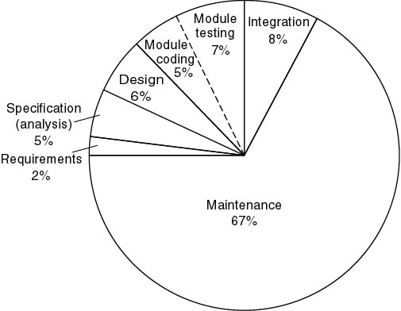
Indicative average cost distribution for software systems
Object-Oriented and Classical Software Engineering, Schach

Slide 10
Part 5
Software Models
The significant problems we face cannot be solved by the same level of thinking that created them. — Albert Einstein
Notes:
This lesson introduces the basic steps in a software engineering project at a high level.
In practice, steps often overlap.

Slide 11
Learning Objectives in this Part
To learn about the different types of Models pertaining to Software Engineering

Slide 12
Models
Each phase in the software life-cycle generates models.
More specifically:
The Requirements Elicitation phase generates various models and specifically, use case models, sequence diagrams, activity diagrams and Non-functional specifications
The Analysis phase generates application domain models as well as PERT Charts, Gantt Charts and Organizational Charts
The Design Phase generates component diagrams, package diagrams, and class diagrams
The Implementation phase generates source code
The Testing phase generates test models etc.

Slide 13
Different Model Categories
System Model:
Object Model: What is the structure of the system? What are the objects and how are they related? (see example on next slide)
Functional Model: What are the functions of the system? How is data flowing through the system? (see example on next slide)
Dynamic Model: How does the system react to external events? How is the event flow in the system ? (see example on next slide)
Task Model:
PERT Chart: What are the dependencies between the tasks?
Schedule: How can this be done within the time limit?
Org Chart: What are the roles in the project or organization?
Issues Model:
What are the open and closed issues? What constraints were posed by the client? What resolutions were made?

Slide 14
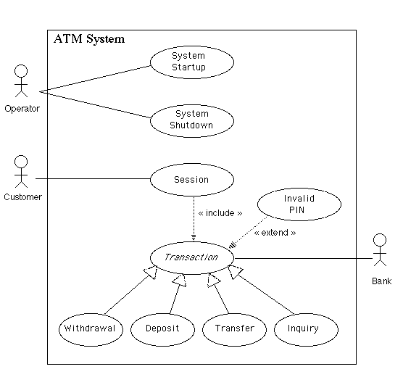
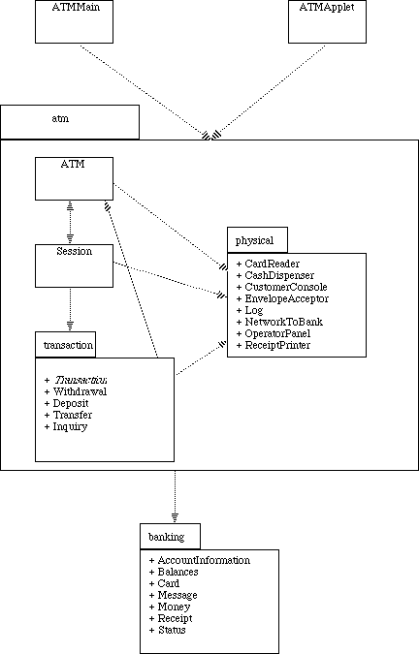
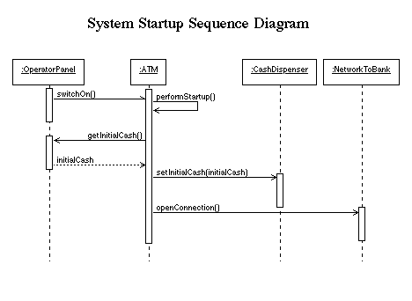
Example Models
Package diagram – Object Model
(at Design Phase)
Use case model – Functional Model
(at Requirements Elicitation Phase)
Sequence diagram – Dynamic Model
(at Requirements Elicitation Phase
http://www.math-cs.gordon.edu/local/courses/cs211/ATMExample/Intro.html

Slide 15
The Modeling Triangle
System Models
Object Model
Forward
Engineering
Reverse
Engineering
class...
class...
class...
Code
Functional
Model
Dynamic Model
Constraints
Arguments
Org Chart
Issues
Pro Con
PERT Chart
Proposals
Gantt Chart
Issue Models
Task Models

Slide 16
Your Turn
Why do we need models to develop software systems. What are these models used for?
What is integration phase in the software life cycle?
Why the maintenance phase is the most costly phase among all the software life-cycle phases?
Read the content of the following sites:
https://en.wikipedia.org/wiki/Systems_development_life_cycle
https://ncube.com/blog/software-development-life-cycle-guide
https://www.sumologic.com/glossary/software-deployment/

